Slide 1
JS WORKSHOP
Just another workshop on JS or is it ? 😀

Slide 2
What is Javascript
JavaScript is a high-level, often just-in-time compiled language that conforms to the ECMAScript standard. It has dynamic typing, prototype-based object-orientation, and first-class functions. It is multi-paradigm, supporting
1. Event-driven
2. Functional

Slide 3
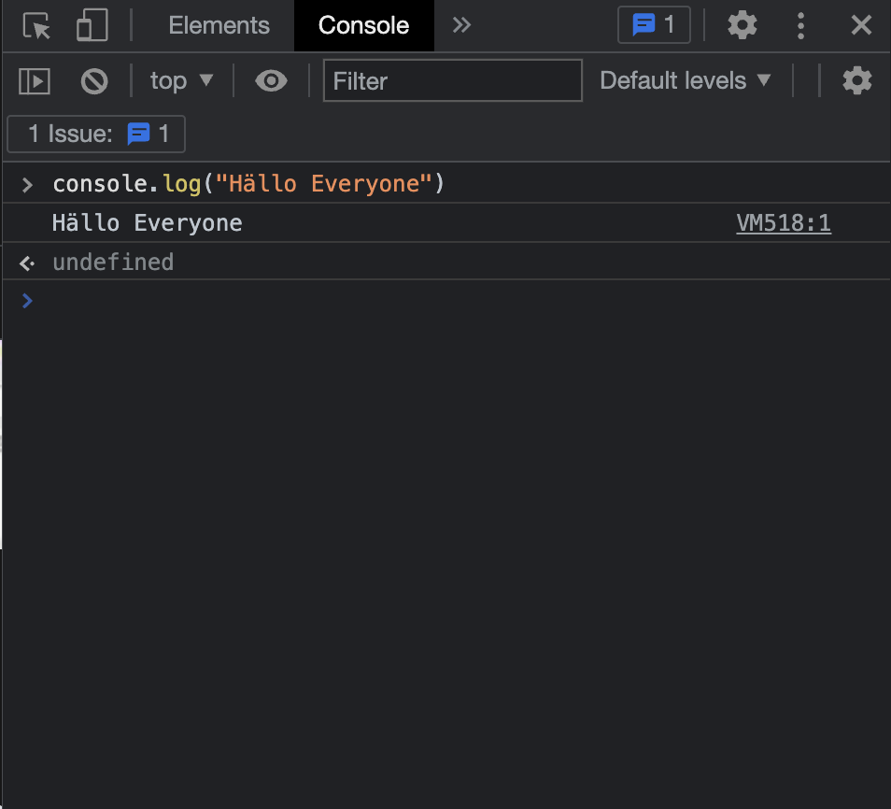
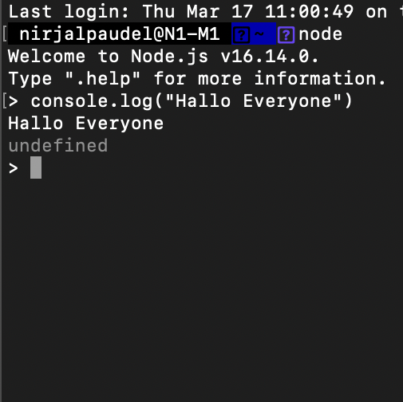
Quickest way to run JS?
Open inspect element in browser and go to console section, you will see REPL or in a terminal using node.

Slide 4
Where is JS used ?
Web application with vanilla JS
Web server with NodeJS
Android development with React Native
Computer app development with electron, etc
What is JavaScript Used For?: A Complete Guide | Career Karma

Slide 5
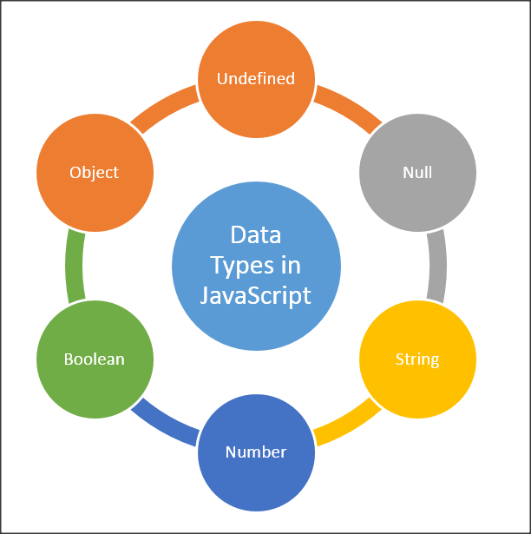
Data types
Different types of data types in JS are listed below
Number → floating point, integer → 1, 2.33, etc
String → “Hola”, “Hello”, “LOL”, “YOLO”, etc
Boolean → true or false
Symbol → Symbol(“Symbol here”)
Objects → Array and Objects
Undefined
Null

Slide 6
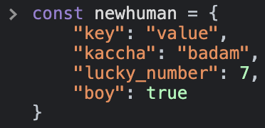
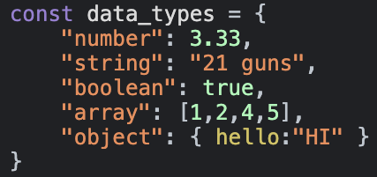
Objects
Objects are key value pairs. It takes a key and a value. Every thing is wrapped around { and }. It can represent real world things.

Slide 7
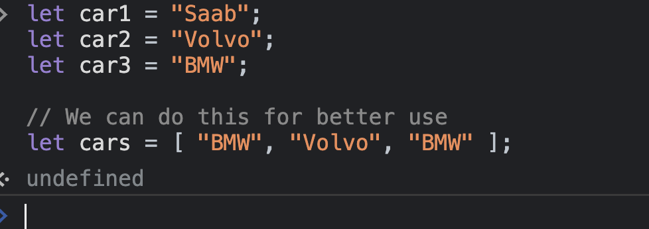
Array
An array is a special variable, which can hold more than one value. Instead of saving values like
NOTE:
Unlike other languages,array can
grow to any length

Slide 8
Null
Undefined
JavaScript uses the null value to represent the intentional absence of any object value.
Undefined means a variable has been declared but has not yet been assigned a value.
https://flexiple.com/undefined-vs-null-javascript/

Slide 9
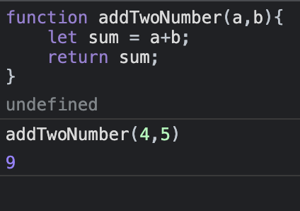
Function
A function is a block of code designed to do a specific task. Inspired by digestion system.
May have a return statement that
return a value.

Slide 10
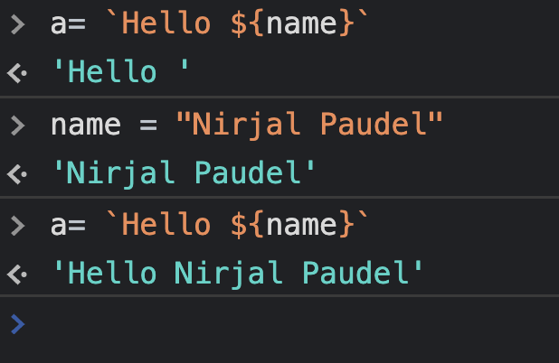
Fun fact - Template string
In js, we can declare string suing template string methods. This is just like using email templates.

Slide 11
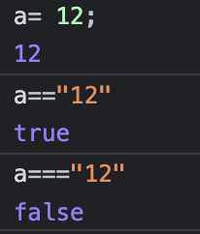
= vs == vs ===
Apart from spelling, their differences are
= is used to assign a value to a variable
== is used to compare between values or variables but
Data type based comparison is not
=== is used to strictly compare between values or variables.

Slide 12
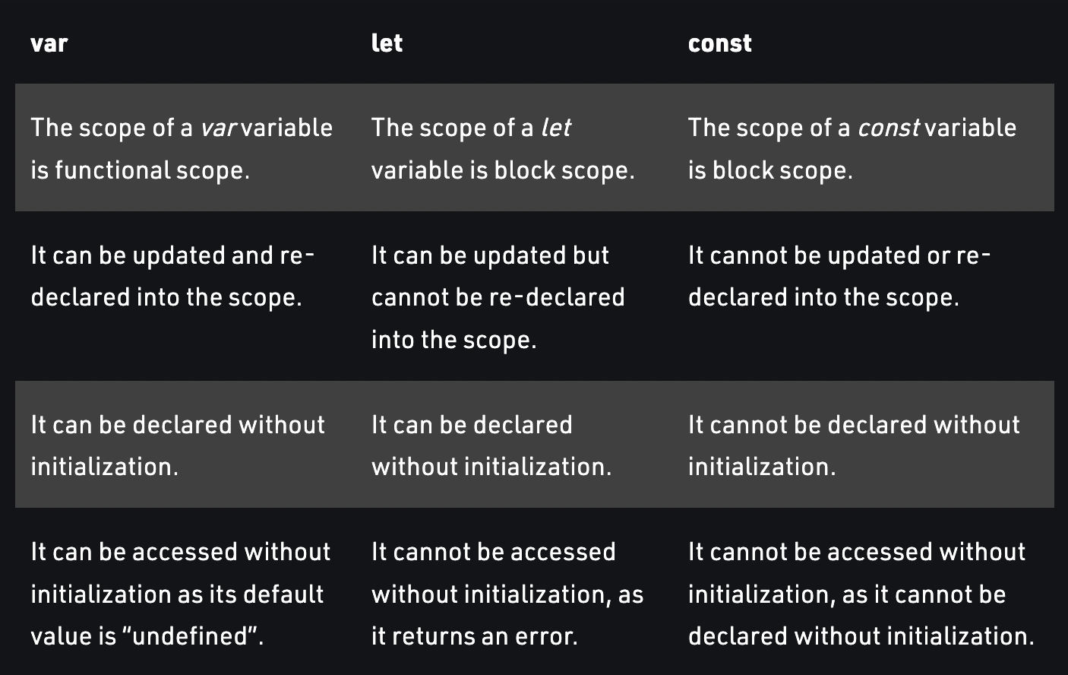
Let vs const vs var

Slide 13
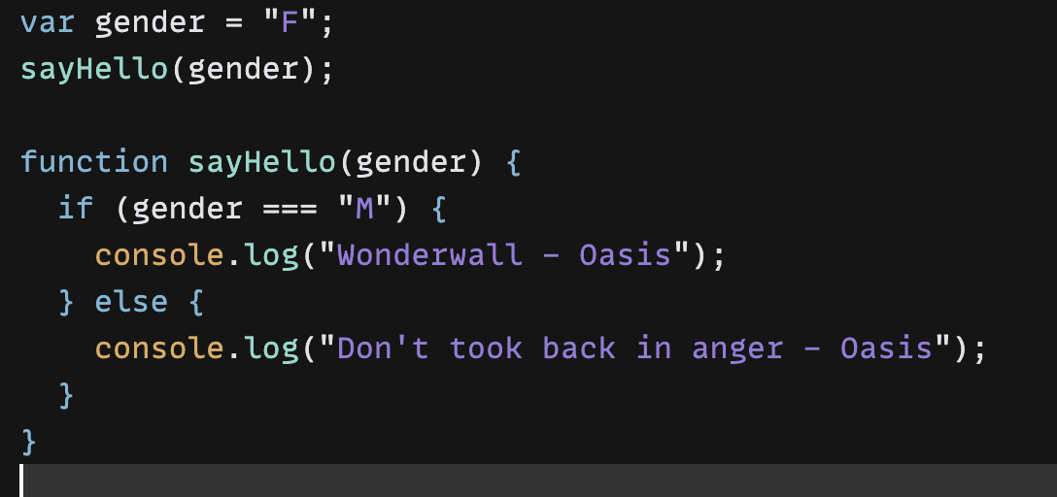
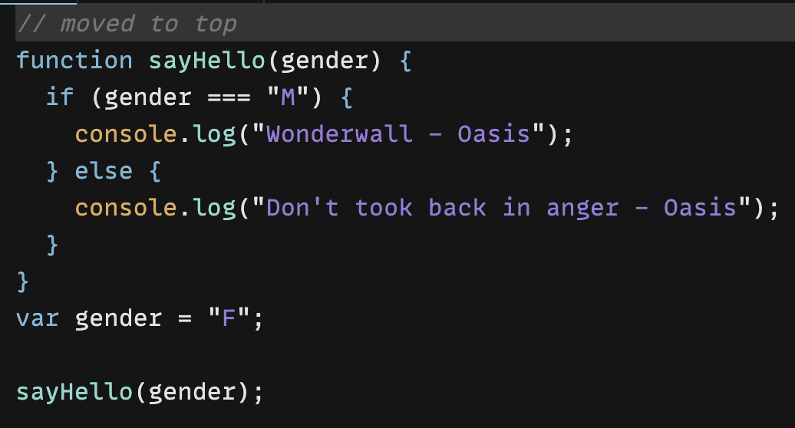
Hoisting
JavaScript Hoisting refers to the process whereby the interpreter appears to move the declaration of functions, variables or classes to the top of their scope, prior to execution of the code. Hoisting allows functions to be safely used in code before they are declared.
What we see What interpreter interprets as

Slide 14
Arrow Function
Discussed earlier, a function what a function is
But arrow function is a compact alternative to the traditional functions. But it does have things like
Differences & Limitations:
Does not have its own bindings to this or super, and should not be used as methods.
Does not have new.target keyword.
Not suitable for call, apply and bind methods, which generally rely on establishing a scope.
Can not be used as constructors.
Can not use yield, within its body.
https://developer.mozilla.org/en-US/docs/Web/JavaScript/Reference/Functions/Arrow_functions https://betterprogramming.pub/when-to-use-bind-call-and-apply-in-javascript-1ae9d7fa66d5

Slide 15
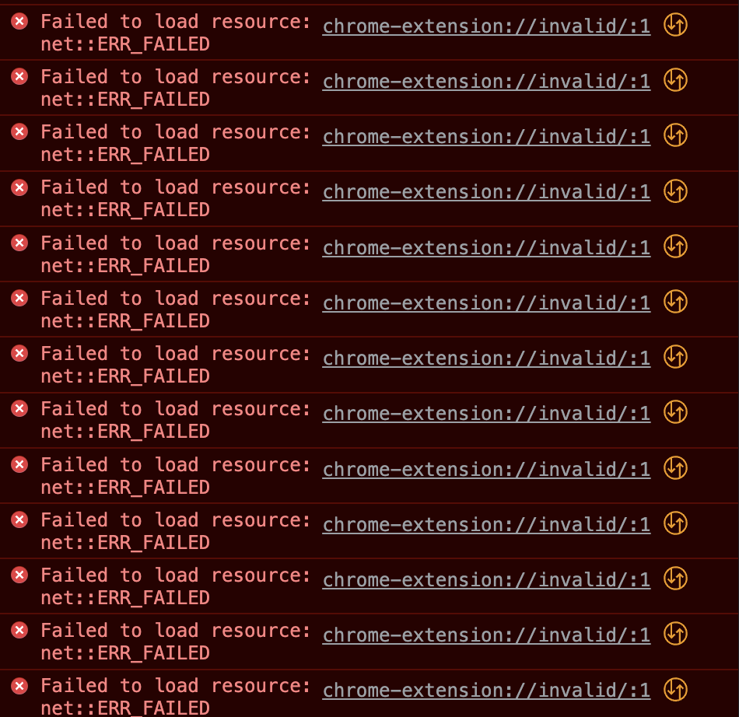
Custom Errors
Almost every things you see in red is error. Error shows that there is something wrong
In your code. We can write custom error in JS, it is done using throw statement
Example
throw 3;
throw 55;

Slide 16
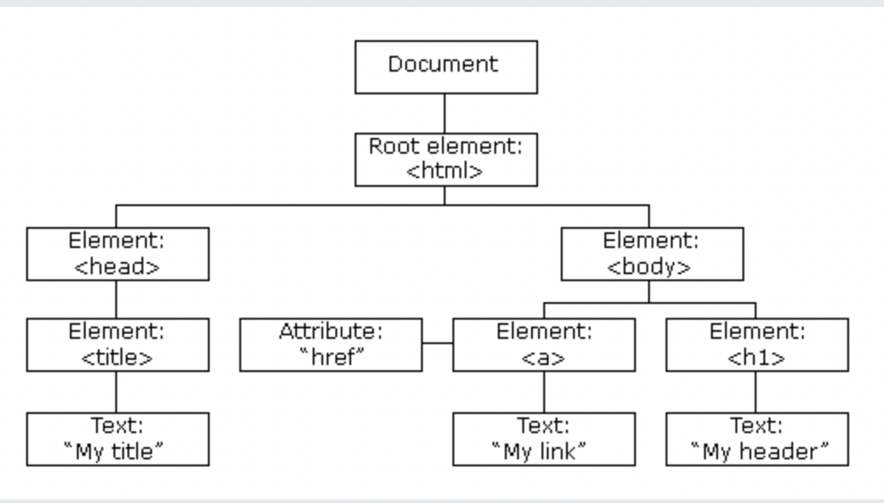
Document Object Model
When a web page is loaded, the browser creates a Document Object Model of the page. Each element in DOM represents what we see on the screen. DOM elements have various properties for style, class-list, id, etc
The HTML DOM model is constructed as a tree of Objects:
Using JavaScript, we can
change all the HTML elements in the page
change all the HTML attributes in the page
change all the CSS styles in the page
remove existing HTML elements and attributes
add new HTML elements and attributes
react to all existing HTML events in the page
create new HTML events in the page
https://developer.mozilla.org/en-US/docs/Web/API/Document_Object_Model

Slide 17
DOM manipulation
Change title of a website
Add a div to an element in website
Change style of an element
Change content of an element using innerHTML
Change content of an element using innerText
Add or remove class to an element
Change id to an element
https://developer.mozilla.org/en-US/docs/Learn/JavaScript/Client-side_web_APIs/Manipulating_documents

Slide 18
DOM events and listeners
Various events take place in the DOM. Events like click, double click, drag, blur, change, etc. As a JS developer, you must learn how to react to these events.
All the DOM events: HTML DOM Event Object
Listeners are attached with a function that gets trigger every time the specified events takes place. Lets see an example.

Slide 19

Who is in for day 2
BUT

Slide 20
End of day 1
Cheat Sheet:
Javascript Cheat Sheet
Docs:
JavaScript and HTML DOM Reference
JavaScript | MDN
JavaScript - GeeksforGeeks
Videos:
JavaScript Programming - Full Course

Slide 21
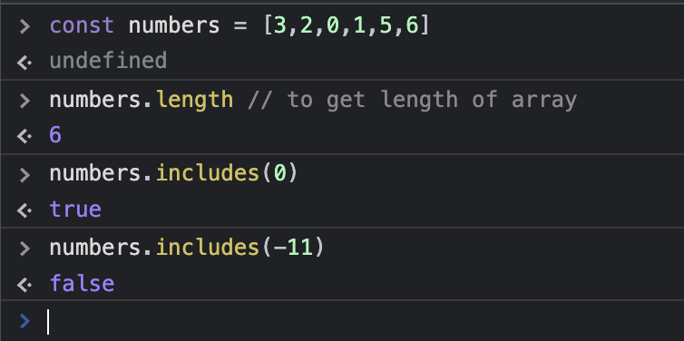
JS Array and array methods
Talked earlier, an array is a collection of dynamic elements. An array has many methods like
Suppose an array of numbers as
But when talking about array methods in
Javascript, we generally talk about, methods
like
find(), findIndex(), filter(), map(), reduce()

Slide 22
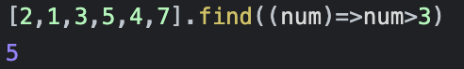
find()
find() : Find is an array method which take a function as an argument (also known as callbacks), returns one of two things
The array element that matches your condition.
undefined when the condition is not matched by any of the element.
[🔥, 💯, 😱, 👀,🏀,😤].find( emoji=> emoji.isAngry() ) → 😤
Learn more about find() method here:
Array.prototype.find() - JavaScript | MDN

Slide 23
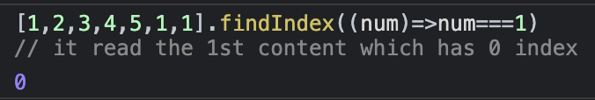
findIndex()
findIndex() : Find is an array method which take a function as an argument (also known as callbacks), returns one of two things
The index of first array element that matches your condition.
-1 when the condition is not matched by any of the element.
[🏀,🔥, 💯, 😱, 👀,🥎].find( emoji=> emoji.isKickAble() ) → 0
Learn more about findIndex() method here:
Array.prototype.findIndex() - JavaScript | MDN

Slide 24
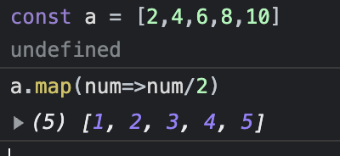
map()
map() : Map is an array method which take a function as an argument (also known as callbacks), and returns a new array with transformation applied.
[1,2,3,4,5].map(num=>num*2) → [2,4,6,8,10]
Learn more about map() method here:
Array.prototype.map() - JavaScript | MDN

Slide 25
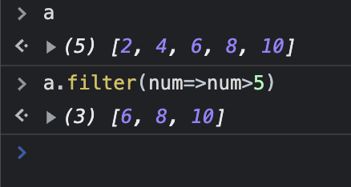
filter()
filter() : filter is an array method which take a function as an argument (also known as callbacks), and returns a new array which satisfies the given condition
[😂, 🥲, 😕, 😳, 🥳].map(emoji=>emoji.isHappy()) → [😂, 🥳]
Learn more about filter() method here:
Array.prototype.filter() - JavaScript | MDN

Slide 26
reduce()
reduce() : reduce is an array method which take a function as an argument (also known as callbacks), and returns a single element that is aggregated by the callback. One of the feared thing in JS
Lets do a hands on
Learn more about reduce() method here:
Array.prototype.reduce() - JavaScript | MDN

Slide 27
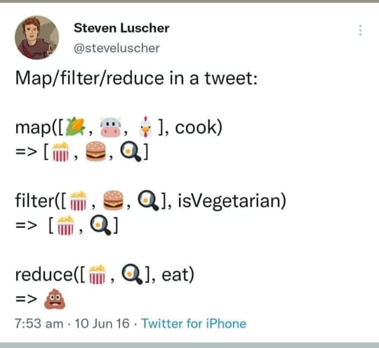
Lets revise
find -> search and get 1st element that matches the condition
findIndex() -> get index of 1st element that matches the condition
map() -> transform every element of the array.
filter() -> get a new array of all the elements of that array which
matches the condition
reduce() -> get a single element that is formed by using all the elements of the given message

Slide 28
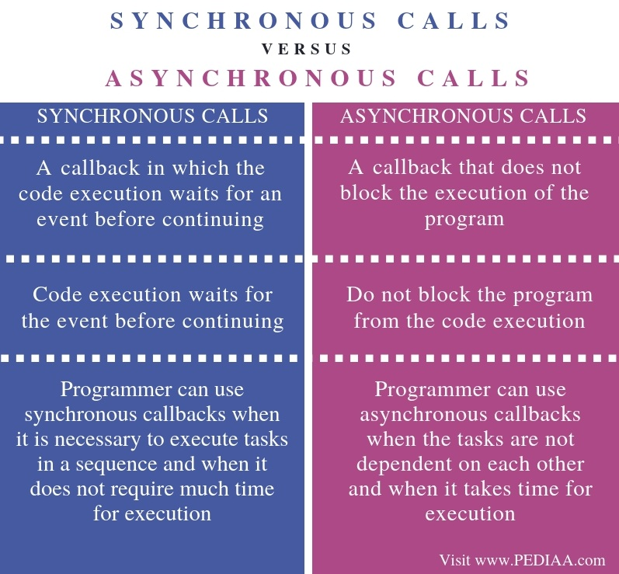
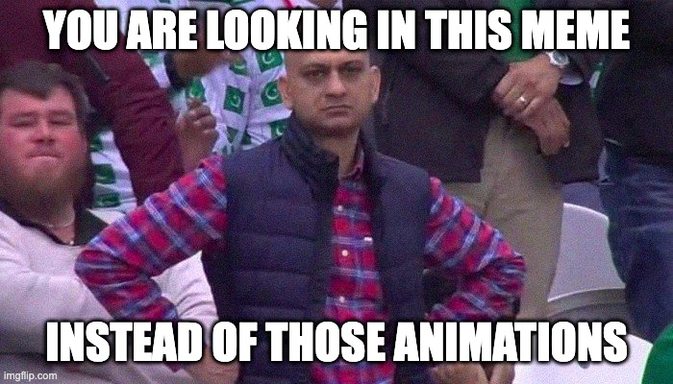

Slide 29
Fetch API
The Fetch API provides an interface for fetching resources (including across the network). It allows programmers to get content of a url. The content can be
JSON
Text
Blob
The response of fetch is not right away so, we will have to react to its response. Fetch returns a promise (like human beings doing promise). It has 3 states
Pending: You make your promise - Here is a hope that it may finish
Fulfilled: You keep your promise - you will react positively.
Rejected: You break your promise - you will pick yourself up.

Slide 30
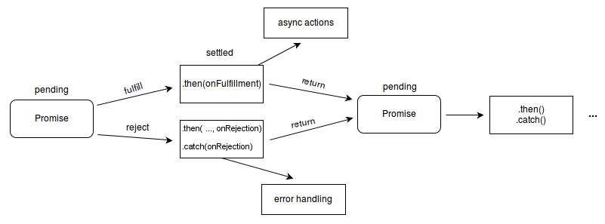
Fetch API Hands On
Let us try to fetch data from a URL. Lets try it on https://jsonplaceholder.typicode.com/users
Please install this extension
JSON Formatter - Chrome

Slide 31
What really happens inside JS ?
There is a concept called event loop that runs Promises or any
Asynchronous code in JS, this is one of the advanced topic in
JS,
Go through this and learn more about event loop
What the heck is the event loop anyway?

Slide 32
End of day - 2
Videos:
Asynchronous JavaScript Course (Async/Await, Promises, Callbacks)
Event loop | Will javascript wait?
8 Must Know JavaScript Array Methods
Docs:
JavaScript | MDN
https://www.youtube.com/c/WebDevSimplified

Slide 33

So what now ?
“ If this workshop is a lion, then JS is a dinosaur. It’s huge ”
So keep learning, keep doing projects and keep learning more.
Want to talk about JS?
LinkedIn: https://www.linkedin.com/in/nirjalpaudel/
Email: me@nirjalpaudel.com
GitHub: https://github.com/n1rjal
Facebook: https://www.facebook.com/n1rjal/

